Slide 1
Final Project
DLCV Fall 2021

Slide 2
Important Deadlines (tentative)
Poster Submission Deadline 2022/1/14 13:00 GMT+8
Kaggle/Eval.ai Challenge Deadline 2022/1/17 23:59 GMT+8
Poster Presentation 2022/1/18 1-5pm GMT+8
GitHub Commit Deadline 2022/1/18 23:59 GMT+8

Slide 3
Introduction
About the final project
Challenges
Challenge 1 Medical images - skull fracture detection
Challenge 2 Medical images - nodule detection
Challenge 3 Fine-grained long-tailed food classification

Slide 4
About Final Project
GitHub
Kaggle / EvalAI
Poster
Presentation
Code / Report*
Grading
Intra/Inter-Team Evaluation
Rules
Challenge Awards (please refer to the “Award” part in each challenge)

Slide 5
GitHub
Each team needs to come up with a team name...
English alphabets and numbers only
You need to use the same team name for Kaggle/Eval.ai.
The team leader creates the team first, and the team members join the team afterwards.

Slide 6
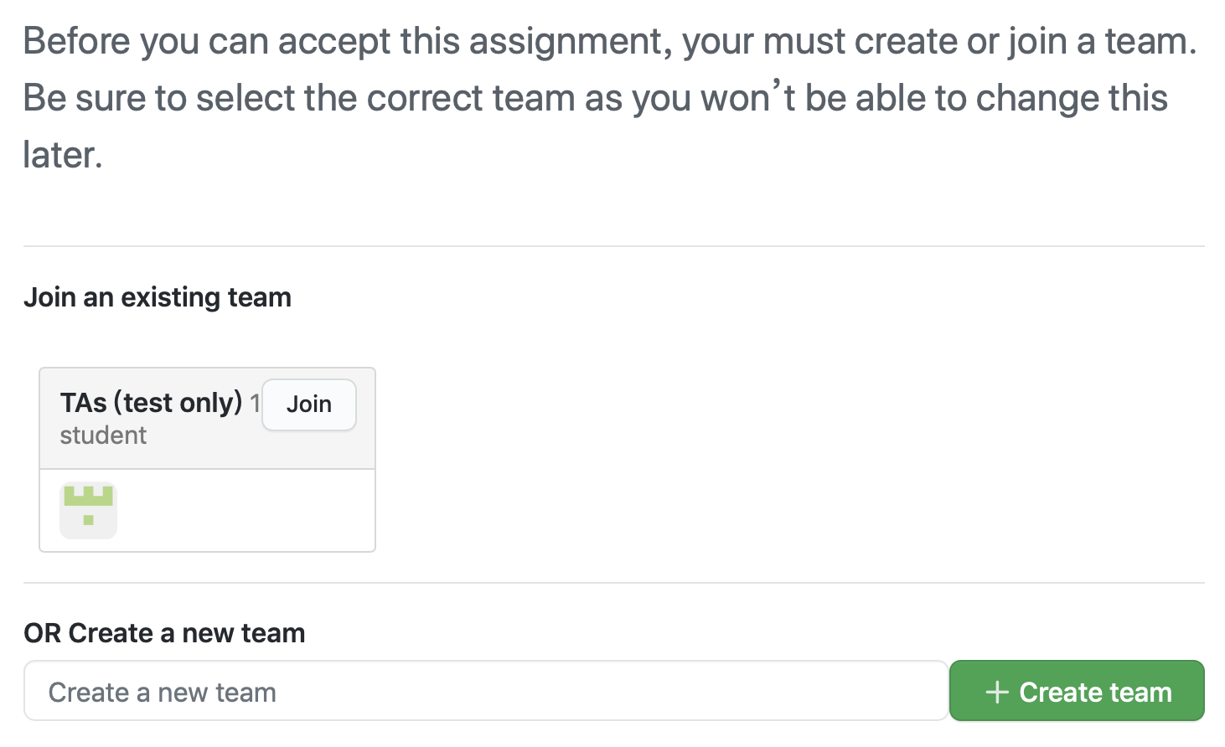
If you are a team leader,
1. Enter your team name here
2. Click “Create team”

Slide 7
If you are a team member,
WARNING
Do not join any team unless your team leader has already created the team.
Do not join a team without asking its leader or members.
Do not join the TA team.
1. Make sure you find the correct team
2. Click “Join”

Slide 8
Kaggle / Eval.ai
You need to participate the kaggle / Eval.ai challenge and compete with your classmates!
Maximum Daily Submissions: 5 times (for each team)
Kaggle: Reset at 08:00 AM (GMT+8) every day
Eval.AI: Reset at 00:00 AM (GMT+8) every day
Challenge deadline: 2022/1/17 23:59 GMT+8 (tentative)

Slide 9
Poster
Format : A1 (Portrait, 84.1 cm x 59.4 cm)
Submission:
You should convert your file into PDF format for submission.
The poster should be submitted in the team’s Github repository (should be in the format poster.pdf).
You may leave some blank areas on your poster (e.g., recognition rates) and fill them up before the final presentation.
If you fail to submit your poster before the submission deadline, you need to print it out by yourself (i.e., using your own budget).

Slide 10

Presentation
Date 2022/1/18 1-5pm (tentative)
Location TBD
More details about poster sessions and final presentation will be announced in the next few weeks.

Slide 11
Code/Report*
The code should be submitted in the team’s Github repository.
You need to modify the "How to run your code?" part of the README file, so that TAs will be able to reproduce your results.
If TAs cannot reproduce your results, you will receive 0 points in the code part. (unless minor errors)

Slide 12
Code/Report*
For the top 3 teams selected for cash awards, an additional technical report needs to be submitted to Github as well (by 2022/1/25 11:59 GMT+8 (tentative); single-column, 4 pages maximum)
Approach (e.g., data preprocessing, model architecture, implementation details, hyperparameter choices, etc.)
Experiments
A template will be provided.

Slide 13
Grading
Final 35% (Bonus up to 3%)
Code / Kaggle / Eval.ai 10% Kaggle / Eval.ai for references, final accuracy evaluated by TAs
Please refer to the “Grading" section in each challenge for more details.
Approach & Presentation 25%
Novelty and technical contribution 10%
Completeness of experiments 10% (e.g., comparisons to baseline and recent models, ablation studies, visualization, etc.)
Presentation (Oral + Poster) 5% + bonus up to 3% (top 3 teams voted by class)

Slide 14
Intra/Inter-Team Evaluation
Intra-Team Evaluation
You must participate and work with your team member.
In the past few semesters, we did assign different scores for team members within the same team.
Inter-Team Evaluation
The most voted team from each challenge will receive bonus points.
Will provide an online form during final presentation (one form per team)

Slide 15
Rules
Please submit your final project to the GitHub repository by the deadline. You will not have any late days, so late submission is not allowed. Besides, any mistake or violation will result in severe penalty (which means your results are questionable).
For each team, if no members show up for the final presentation, all team members will receive 0 points for this part (0 out of 25 points).

Slide 16
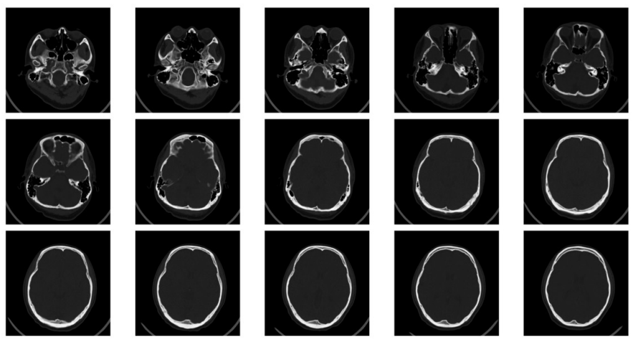
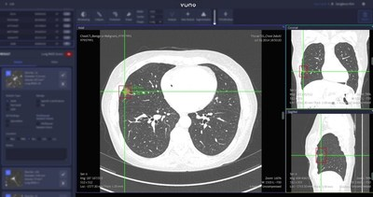
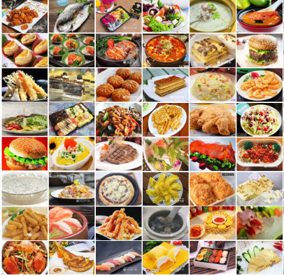
Tasks
Challenge 1 Skull fracture detection
Challenge 2 Nodule detection
Challenge 3 Fine-grained long-tailed food classification

Slide 17
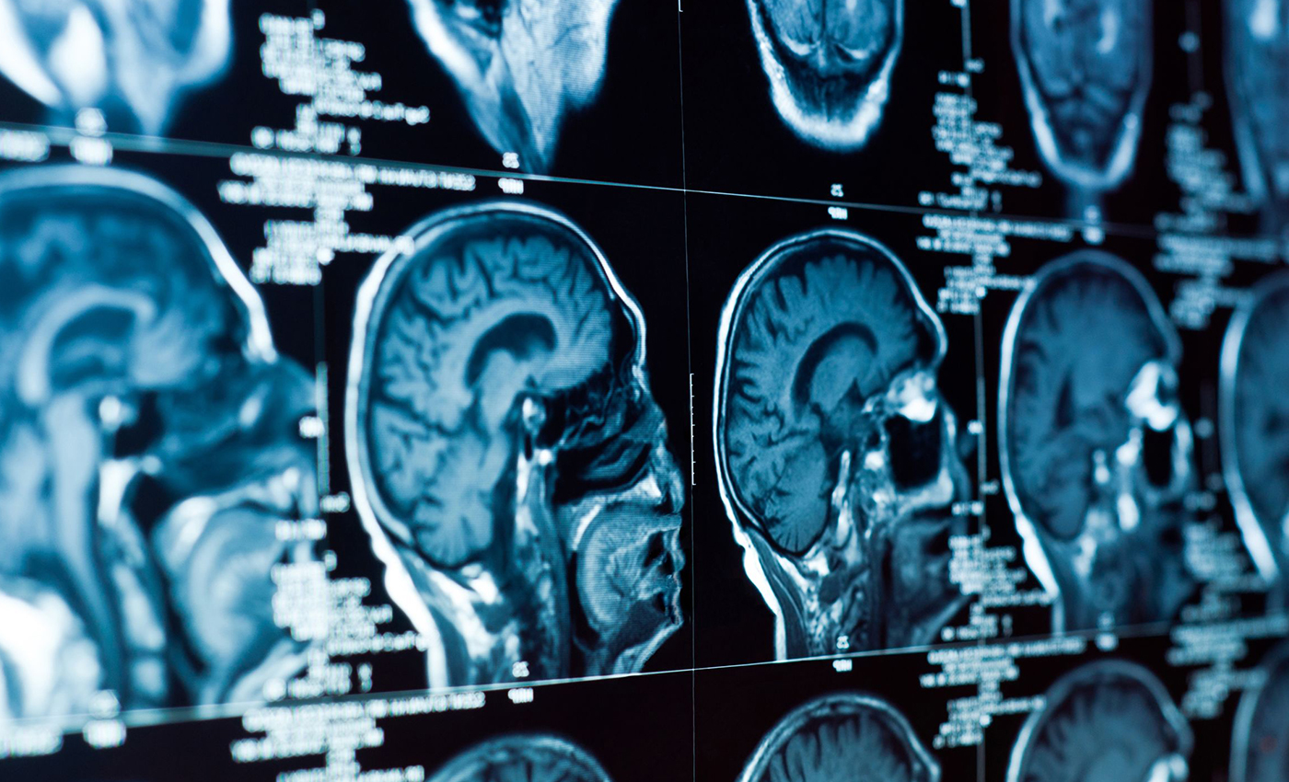

Challenge I
Skull fracture
detection
Sponsered by Deep01

Slide 18
Outline
Introduction
Challenges
Dataset
Evaluation
Grading
Challenge Awards
Rules

Slide 19
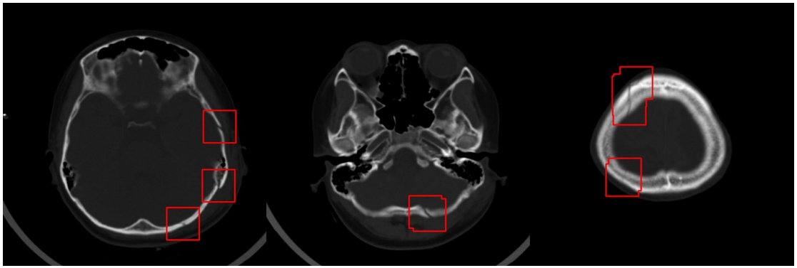
Introduction
Dataset Computer tomography (電腦斷層影像) of different patients with skull Fractures (腦部骨折)
Goal Train a neural network to detect whether the patient has skull fractures and where they are by utilizing data annotated by physicians.
Task Object detection

Slide 20
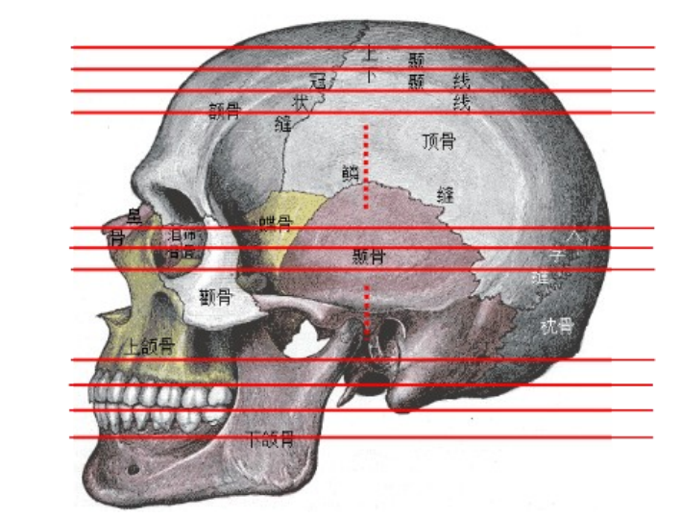
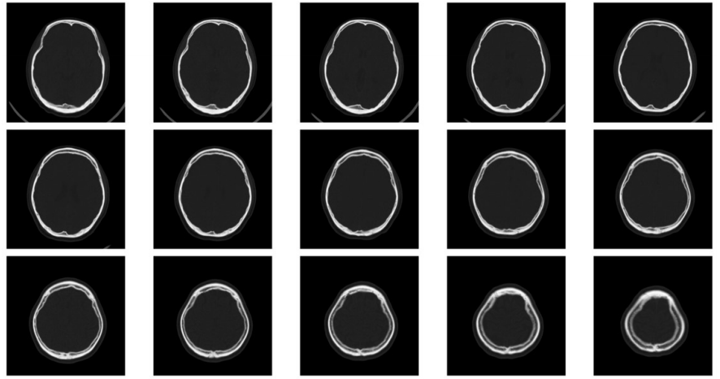
Challenges - Things are not that easy!
Medical images are quite different from those in COCO or Visual Genome datasets. (e.g., RGB images)
Some cases of skull fracture are very similar to the normal skull sutures (non-fractures) in the CT imaging.
CT images can be viewed as sequential data:
If you treat each frame as independent inputs, the performance may be limited.

Slide 21
Dataset
Training set (with label)
32,665 images in total, with 1,116 study series (patients)
Testing set (without label)
3,775 images in total, with 130 study series (patients)
Download link

Slide 22
Dataset -- File Structure
skull/
├── train/
│ ├── 醫院_Study_Series/
│ │ ├── 醫院_Study_Series_SliceID.npy
│ │ └── ...
│ └── .../
├── test/
│ ├── 醫院_Study_Series/
│ │ ├── 醫院_Study_Series_SliceID.npy
│ │ └── ...
│ └── .../
│
├── readme.txt
├── records_train_readme.txt
└── records_train.json
training dataset
testing dataset
dataset introduction
annotation introduction
training data annotation

Slide 23
Evaluation
Case-Level Accuracy: identify if the patient has skull fractures
Centroid-Level F1 Score: detect where the skull fractures are in each CT slice
Patient ID | CT Slice ID | Skull Fracture Coordinates (if any) | Label Annotation in the dataset | Case-Level Ground Truth
001 | 1 |  | -1 (no fracture in this slice) | 1 (positive)
 | 2 | (12, 34), (56, 78) | 1
 | 3 | (23, 45) | 1
 | 4 |  | -1 (no fracture in this slice)
002 | 1 |  | 0 | 0 (negative)
 | 2 |  | 0
Your code should output predicted label (-1, 0, 1) and coordinates for each CT slice, and we have provided the code that can calculate the case-level accuracy and F1 score based on your output.

Slide 24
Evaluation - Centroid-Level F1-Score
Evaluate the predicted skull fracture points (coordinates)
We provide the code for F1 score evaluation in for_students_eval.py
Usage: python3 for_students_eval.py --pred_file {pred.csv} --gt_file {gt.csv}
{pred.csv} / {gt.csv} should follow the sample output format (csv) in the following pages
For validation, you can generate the gt.csv on your own by the provided training annotation
True Positive, TP （正確偵測） | Given a GT positive point, a TP exists when there are one or more predicted points inside the circle (radius=32) centered at the GT point.
False Negative, FN （遺漏偵測） | Given a GT positive point, a FN exists when there is no predicted point inside the circle (radius=32) centered at the GT point.
False Positive, FP （錯誤偵測） | For those predicted points that are not inside any circles centered at GT positive points, we perform DBSCAN clustering and get the cluster centers. Each cluster center counts for one FP.
Precision (P) = TP / (TP+FP)
Recall (R) = TP / (TP+FN)
F1 Score = 2PR / (P+R)

Slide 25
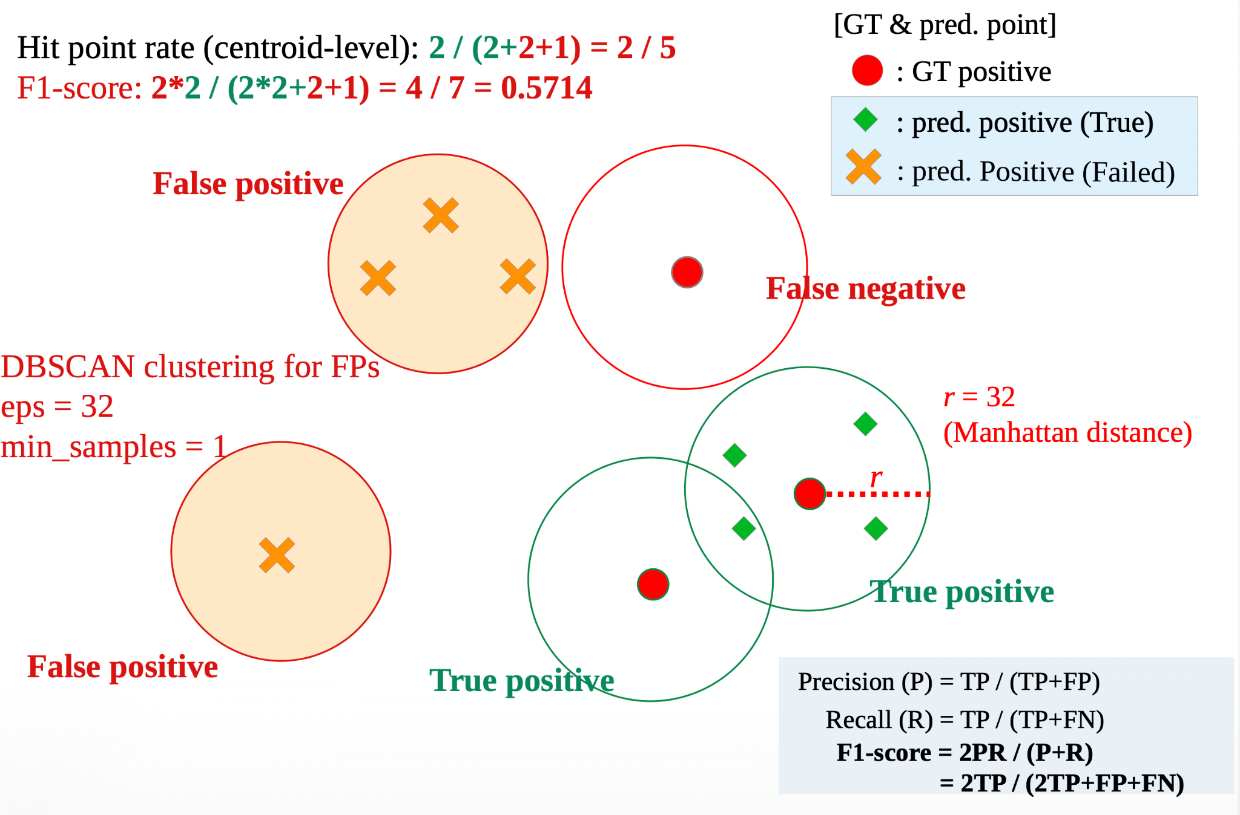
Evaluation - Centroid-Level Hit Rate

Slide 26
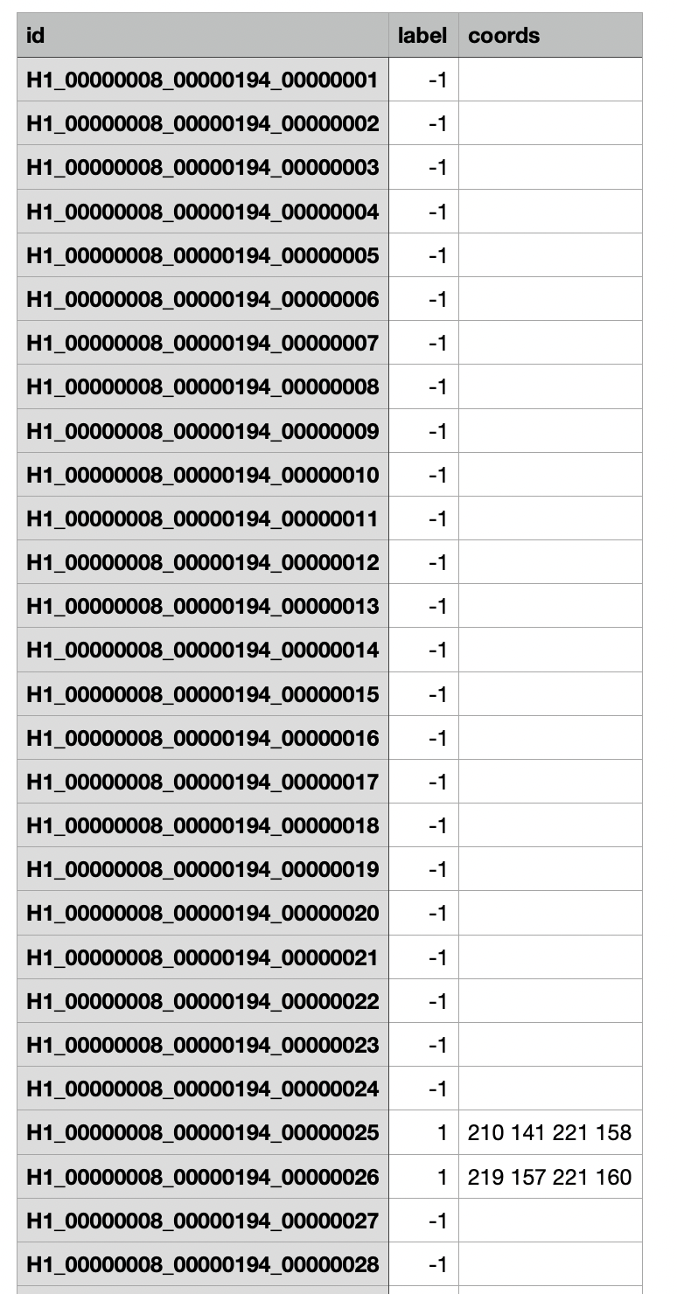
Sample Output (csv)
slice id
slice label
coords: x1 y1 x2 y2 …

Slide 27
Grading
Relative ranking (case-level / F1 score)
Score | Points | Topic 1
 | 2.5% | 3
 | 2.0% | 3
 | 1.5% | 2
 | 1.0% | 2
 | 0.5% | 2
Final 35% (Bonus up to 3%)
Code / Eval.ai 10% Eval.ai for references, final accuracy evaluated by TAs
Baseline 5% (case-level 2.5% / F1 score 2.5%)
Relative ranking in the class 5% (case-level 2.5% / F1 score 2.5%)
Approach & Presentation 25%
Novelty and technical contribution 10%
Completeness of experiments 10% (e.g., comparisons to baseline and recent models, ablation studies, visualization, etc.)
Presentation (Oral + Poster) 5% + bonus up to 3% (top 3 teams voted by class)
highest
lowest
(number of teams)

Slide 28
Challenge Awards
Top three teams for overall performance (accuracy, presentation, novelty…)
1st: NTD $10k
2nd: NTD $5k
3rd: NTD $3k
Extra two winners for model performance (case level 50% / F1 score 50%)
1st: NTD $ TBD
2nd: NTD $ TBD

Slide 29
EvalAI & Github links
EvalAI Competition Link:
LINK
Github Link:
LINK
The team leader should create a team on EvalAI with the same team name as in the GitHub Classroom.
It is strictly prohibited for members in the same team to create multiple teams on EvalAI.

Slide 30
(Super Important) Rules
Do not disclose the dataset! Dataset 請勿外流！
You are NOT allowed to use any pretrained models or data related to computer tomography, but other types of pretrained models or datasets (e.g., MRI, ImageNet, etc.) are OK.
Your models and scores need to be reproducible.
Any violation would result in 0 score for your final project!!

Slide 31
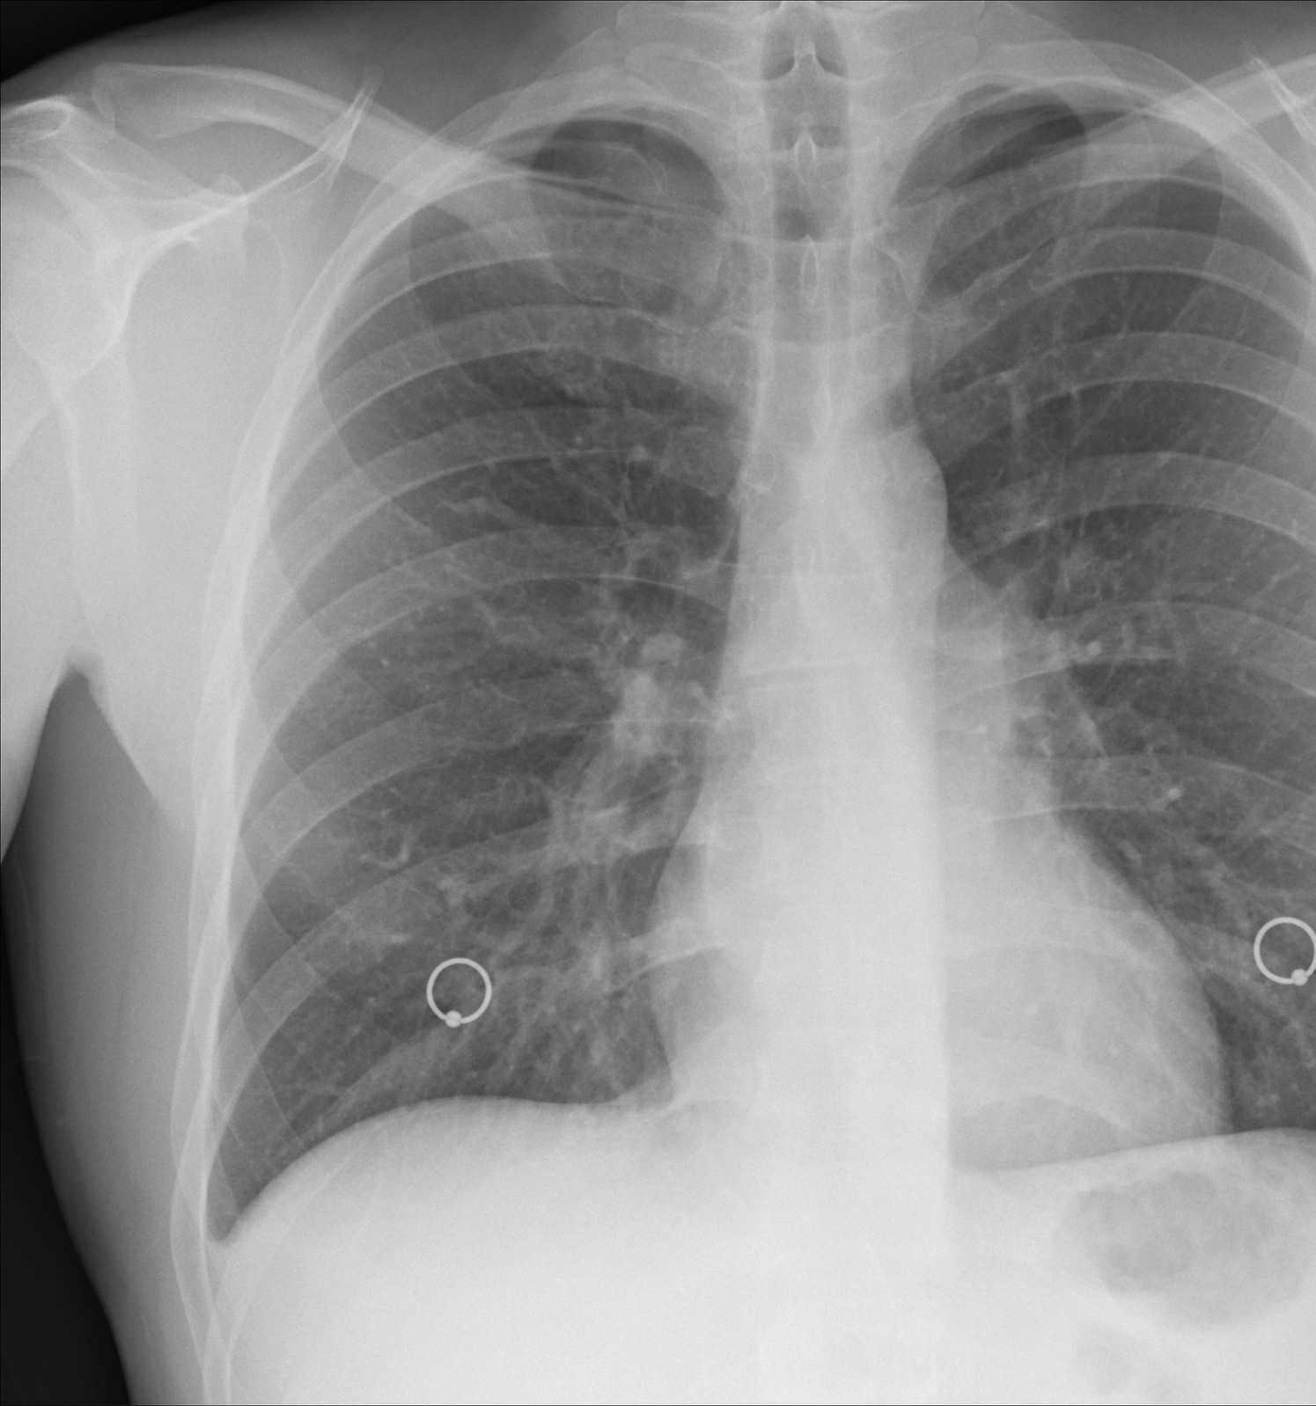

Challenge II
Nodule detection
Sponsered by Inventec

Slide 32
Outline
Introduction
Challenges
Dataset
Evaluation
Grading
Challenge Awards
Rules

Slide 33
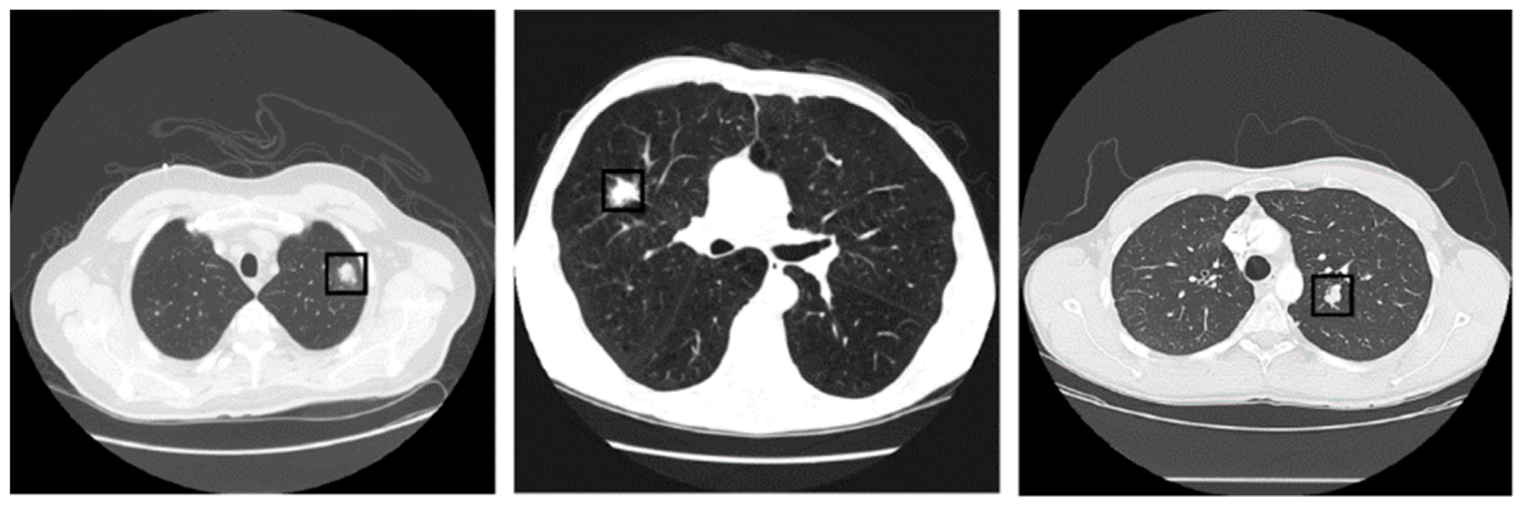
Introduction
Dataset Computer tomography (電腦斷層影像) of different patients with pulmonary nodules (肺結節)
Goal Train a neural network to Identify locations of the possible nodules that is larger than 3 mms by utilizing data annotated by several experienced radiologists.
Task object detection

Slide 34
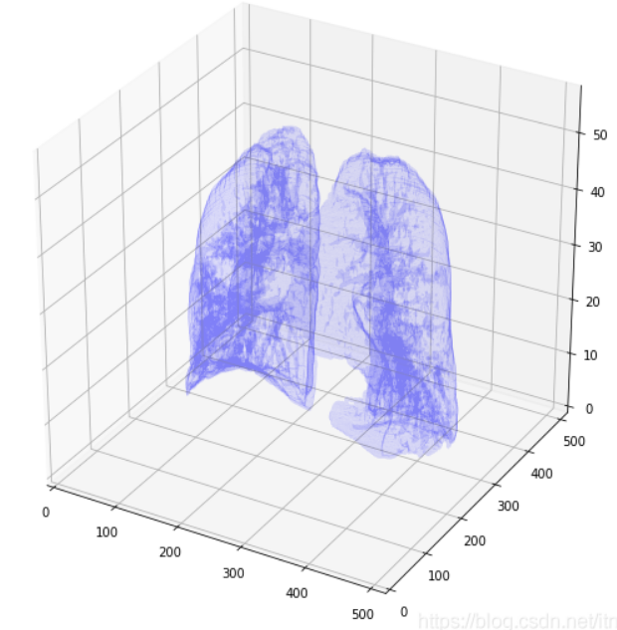
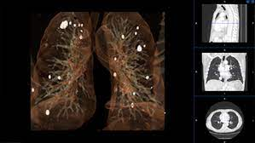
Challenges - Things are not that easy!
Medical images are quite different from those in COCO or Visual Genome datasets. (e.g., RGB images)
The given data may be in the 3D voxel format. Therefore, Use the 3D lung nodule feature might make the interpretation of nodule easier.
The similarity in the morphological appearance of some false positive candidates to that of true pulmonary nodules further increases the difficulty in detection

Slide 35
Dataset
CT images of different patients with pulmonary nodules
Training set (with label)
267 patients, with 70,315 images in total
Testing set (without label)
89 patients, with 22,870 images in total
Download link: please refer to get_dataset.sh in Github
This dataset is large, so you may preprocess the data.

Slide 36
Dataset - File Structure
data/
├── train/
│ ├──1.3.6.1.4.1.14519.5.2.1.6279.6001.100684836163890911914061745866.raw
│ ├──1.3.6.1.4.1.14519.5.2.1.6279.6001.100684836163890911914061745866.mhd
│ └── ...
├── test/
│ ├──1.3.6.1.4.1.14519.5.2.1.6279.6001.105756658031515062000744821260.raw
│ ├──1.3.6.1.4.1.14519.5.2.1.6279.6001.105756658031515062000744821260.mhd
│ └── ...
├── annotations.csv
├── sampleSubmission.csv
└── sample_seriesuids.csv
Training 3D voxels
.mhd contains the header of voxels
.raw contains the voxels
Testing 3D voxels
.mhd contains the header of voxels
.raw contains the voxels

Slide 37
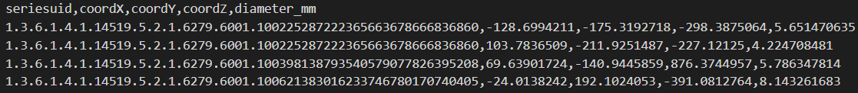
Dataset - File Structure
data/
├── train/
│ ├──1.3.6.1.4.1.14519.5.2.1.6279.6001.100684836163890911914061745866.raw
│ ├──1.3.6.1.4.1.14519.5.2.1.6279.6001.100684836163890911914061745866.mhd
│ └── ...
├── test/
│ ├──1.3.6.1.4.1.14519.5.2.1.6279.6001.105756658031515062000744821260.raw
│ ├──1.3.6.1.4.1.14519.5.2.1.6279.6001.105756658031515062000744821260.mhd
│ └── ...
├── annotations.csv
├── sampleSubmission.csv
└── sample_seriesuids.csv
Seriesuids of training set
This csv file is for the evaluation on training set.
Annotations of training set
Each line holds the SeriesInstanceUID of the scan, the x, y, z position of each finding in world coordinates, and the corresponding diameter in mm.

Slide 38
Evaluation
A detected candidate is considered to be a true positive if the candidate is located within a distance R of the nodule center, where R is set to the diameter of the nodule divided by 2.
Metrics: free receiver operating characteristic (FROC) analysis.
The final score is defined as the average sensitivity at 7 predefined false positive rates: 1/8, 1/4, 1/2, 1, 2, 4, and 8 FPs per scan.
We provide evaluation code to compute the final score.
Usage:
python3 evaluation.py {annotations.csv} {submission.csv} {seriesuids.csv}

Slide 39
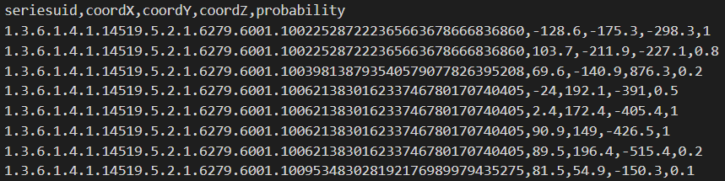
Evaluation - Sample Submission
We provide sampleSubmission.csv as an example of a submission file in the correct format.
Each line holds the SeriesInstanceUID of the scan, the x, y, z position of each finding in world coordinates, and the corresponding probability.

Slide 40
Grading
Relative ranking (Public / Private)
Score | Points | Topic 2
 | 2.5% | 3
 | 2.0% | 3
 | 1.5% | 2
 | 1.0% | 2
 | 0.5% | 2
Final 35% (Bonus up to 3%)
Code / Eval.ai 10% Eval.ai for references, final accuracy evaluated by TAs
Simple baseline 4% (Public 2% / Private 2%)
Strong baseline 1% (Public 0.5% / Private 0.5%)
Relative ranking in the class 5% (Public 2.5% / Private 2.5%)
Approach & Presentation 25%
Novelty and technical contribution 10%
Completeness of experiments 10% (e.g., comparisons to baseline and recent models, ablation studies, visualization, etc.)
Presentation (Oral + Poster) 5% + bonus up to 3% (top 3 teams voted by class)
highest
lowest
(number of teams)

Slide 41
Challenge Awards
Top three teams
1st: NTD $10k
2nd: NTD $5k
3rd: NTD $3k
(Optional) Special challenge/award [TBD]

Slide 42
EvalAI & Github links
EvalAI Competition Link:
LINK
Github Link:
LINK
The team leader should create a team on EvalAI with the same team name as in the GitHub Classroom.
It is strictly prohibited for members in the same team to create multiple teams on EvalAI.

Slide 43
(Super Important) Rules
You are NOT allowed to use any pretrained models or data related to computer tomography, but other types of pretrained models or datasets (e.g., MRI, ImageNet, etc.) are OK.
Your models and scores need to be reproducible.
Any violation would result in 0 score for your final project!!

Slide 44
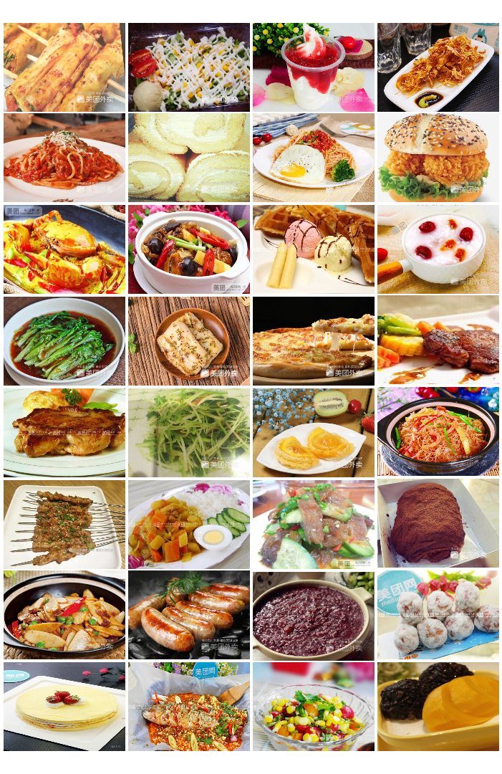


Challenge III
Fine-grained long-tailed
food image classification
ICCV’21 Workshop

Slide 45
Outline
Introduction
Challenges
Dataset
Evaluation
Grading
Kaggle / Github links
Challenge Award
Rules

Slide 46
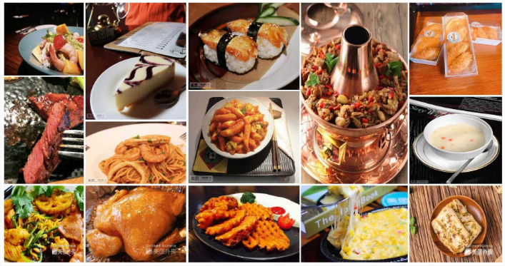
Introduction
Dataset Large Scale Visual Food Recognition dataset (LSVFR)
Goal Train a neural network to classify the given food images.
Task Classification

Slide 47
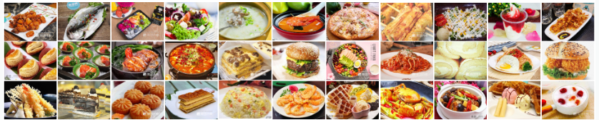
Challenges - Things are not that easy!
Fine-Grained Image Classification!
Imbalanced data distribution is a common problem in the food analysis (or many real-world applications).
Large-scale dataset might contains 100,000+ images with 200+ different categories!

Slide 48
Dataset
Training set (with label)
140,708 images in total, with 1,000 categories
As shown in Table 1, the categories are divided into three groups (frequent, common, and rare categories) based on the amount of data of each category.
# of frequent/common/rare categories: 290 / 561 / 149
Val / Testing set
31,263 / 38,425 images in total
Download link
Download link (backup)
Categories | Frequent | Common | Rare
# of data | 100+ | 10 <= & < 100 | < 10
Table 1. Definition of the frequent, common, and rare categories.

Slide 49
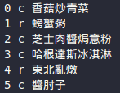
Dataset -- File Structure
food_data/
├── train/
│ ├── 0/
│ │ ├── 16330004.jpg
│ │ └── ...
│ └── .../
├── val/
│ ├── 0/
│ │ ├── 16330009.jpg
│ │ └── ...
│ └── .../
├── test/
│ ├── 000000.jpg
│ └── ...
├── testcase/
│ ├── sample_submission_main_track.csv
│ └── …
│
└── label2name.txt
Training Images
class_id/{imageID}.jpg
Testing Images
{imageID}.jpg
class_id, freq/comm/rare, name
...

Slide 50
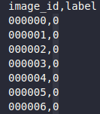
Dataset -- File Structure
food_data/
├── train/
│ ├── 0/
│ │ ├── 16330004.jpg
│ │ └── ...
│ └── .../
├── val/
│ ├── 0/
│ │ ├── 16330009.jpg
│ │ └── ...
│ └── .../
├── test/
│ ├── 000000.jpg
│ └── ...
├── testcase/
│ ├── sample_submission_main_track.csv
│ └── …
│
└── label2name.txt
These csv files identify the images for each testing track. The image file can be founded in test/ with the name of "image_id".jpg, and the labels are all dummy terms (i.e., "0"). Once you replace the labels with the prediction results of your model, you can upload this file to kaggle directly.
e.g., sample_submission_main_track.csv
Note that these csv files are for the testing only, and you are not allow to pre-classify the testing images into frequent / common / rare categories by scraping these files.

Slide 51
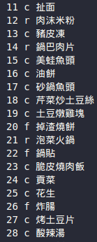
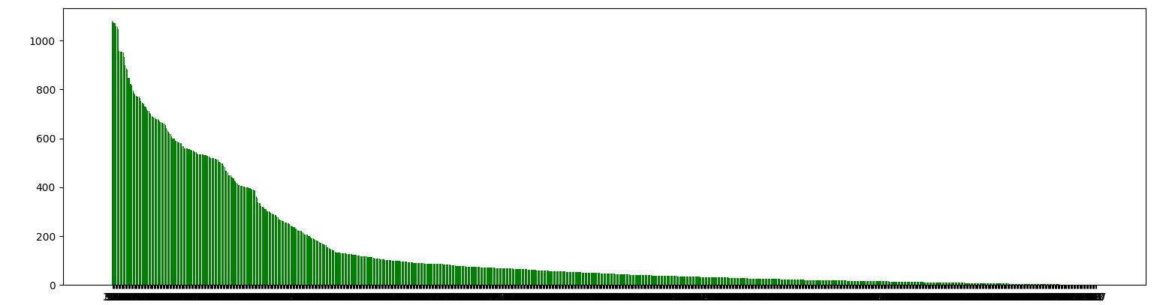
Evaluation
Top-1 classification accuracy is used for evaluation.
Report classification accuracy on the frequent/common/rare categories separately.
Baseline Accuracy (test set):
 | All | Freq. | Common | Rare
Accuracy | 0.6617 | 0.8457 | 0.6336 | 0.2439

Slide 52
Grading
Relative ranking (Public / Private)
Score | Points | Topic 3
 | 100% | 3
 | 75% | 3
 | 50% | 2
 | 25% | 1
 | 0% | 1
Final 35% (Bonus up to 3%)
Code / Kaggle 10% Kaggle / Eval.ai for references, final accuracy evaluated by TAs
Main track
Baseline 2% (Public 1% / Private 1%)
Relative ranking in the class 2% (Public 1% / Private 1%)
Each Freq./Comm./Rare track
Baseline 1% (Public 0.5% / Private 0.5%)
Relative ranking in the class 1% (Public 0.5% / Private 0.5%)
Approach & Presentation 25%
Novelty and technical contribution 10%
Completeness of experiments 10% (e.g., comparisons to baseline and recent models, ablation studies, visualization, etc.)
Presentation (Oral + Poster) 5% + bonus up to 3% (top 3 teams voted by class)
highest
lowest
(number of teams)

Slide 53
Kaggle & Github links
Kaggle Competition Link:
Main track: LINK
Track for frequent categories: LINK
Track for common categories: LINK
Track for rare categories: LINK
Github Link: LINK
The team leader should create a team on Kaggle with the same team name as in the GitHub Classroom.
It is strictly prohibited for members in the same team to create multiple teams on Kaggle.

Slide 54
Challenge Awards (tentative)
Top three teams for overall performance (accuracy, presentation, novelty…)
1st: NTD $10k
2nd: NTD $5k
3rd: NTD $3k

Slide 55
(Super Important) Rules
Do not disclose the dataset! Dataset 請勿外流！
You are NOT allowed to use any pretrained models or data related to Food analysis workshop, but other types of pretrained models or datasets (e.g., ImageNet, etc.) are OK.
Your models and scores need to be reproducible. (Including both train & inference phases)
Any violation would result in 0 score for your final project!!

Slide 56
Have fun !

